Slide 1

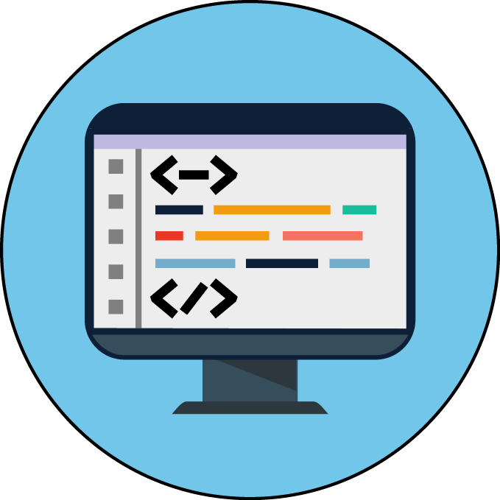

Slide 2
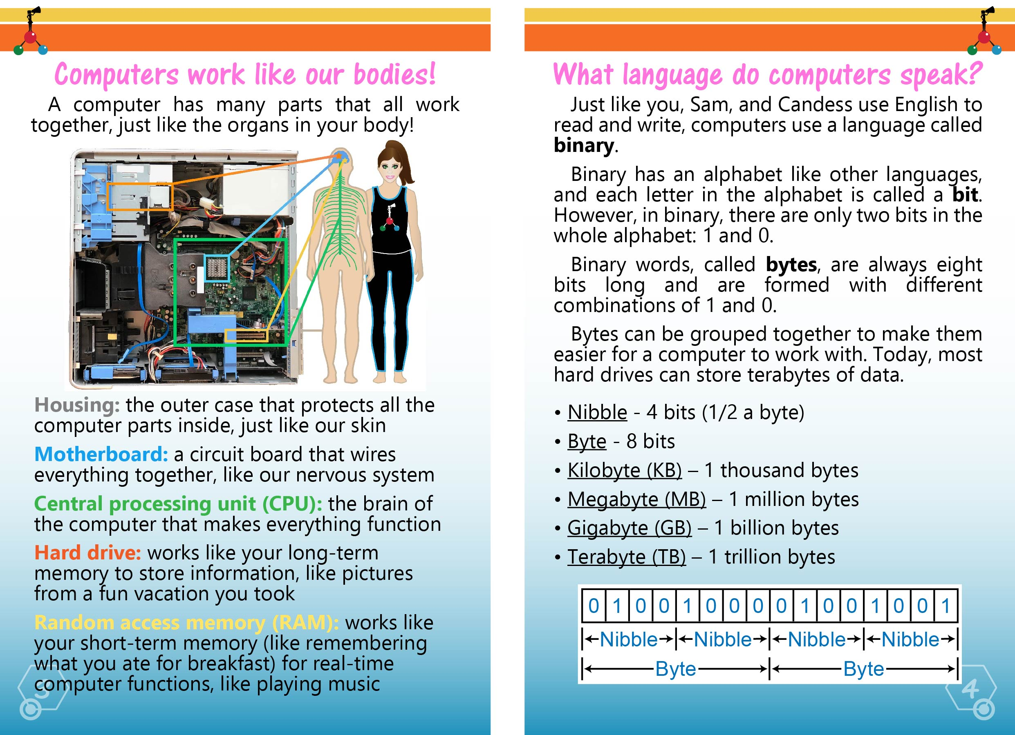

Computers work just like our bodies
Housing: the outer case that protects all the
computer parts inside, just like our skin
Motherboard: a circuit board that wires
everything together, like our nervous system
Central processing unit (CPU): the brain of
the computer that makes everything function
Hard drive: works like your long-term
memory to store information, like pictures
from a fun vacation you took
Random access memory (RAM): works like
your short-term memory (like remembering
what you ate for breakfast) for real-time
computer functions, like playing music

Slide 3
What Language do computers speak?
Computers use binary
Binary has an alphabet like other languages – each letter is called a bit
There are only two bits:
0 and 1
Words in binary are called bytes and are always 8 bits long
Today, most hard drives can store terabytes, or one trillion bytes, of data
Nibble - 4 bits (1/2 a byte)
Byte - 8 bits
Kilobyte (KB) – 1 thousand bytes
Megabyte (MB) – 1 million bytes
Gigabyte (GB) – 1 billion bytes
Terabyte (TB) – 1 trillion bytes

Slide 4
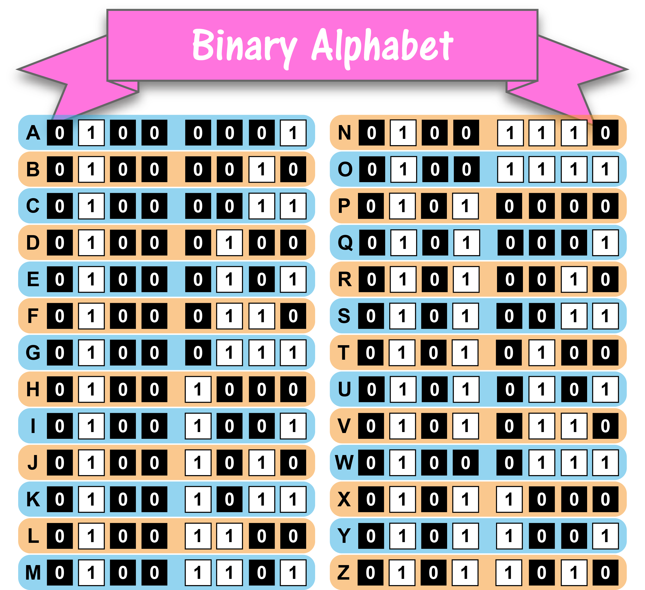
The Binary Alphabet
All information and instructions computers need to work are encoded in binary
Using the binary alphabet, we can translate letters from the English alphabet into bytes, and then combine bytes to form words
Using the binary alphabet, check out how to write different letters in binary!

Slide 5
Try it!
Use the binary alphabet to decode this science-themed cheer!
2, 4, 6, 8, let’s (01000111 01001111)¹
(01010011 01000011 01001001 01000101 01001110 01000011 01000101)²!
Give me an (01010011)³!
Give me an (01000011)⁴!
Give me an (01001001)⁵!
Give me an (01000101)⁶!
Give me an (01001110)⁷!
Give me an (01000011)⁸!
Give me an (01000101)⁹!
2, 4, 6, 8, (01001001)¹⁰
(01001100 01001111 01010110 01000101)¹¹
science!
Key: 1go, 2science, 3s, 4c, 5i, 6e, 7n, 8c, 9e, 10I, 11love

Slide 6
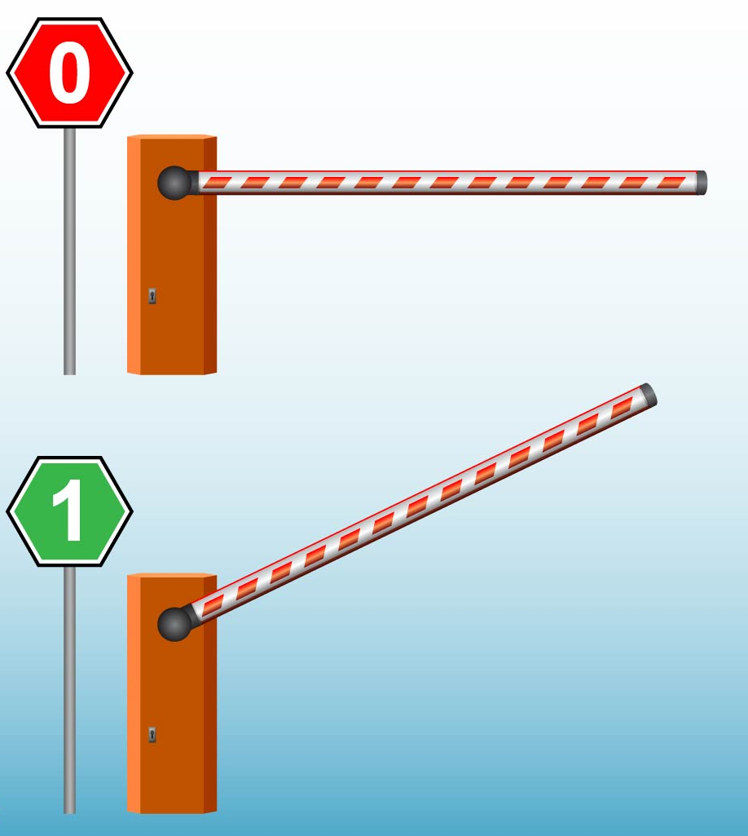
How do computers read?
Just like the cells inside your brain, there are billions of transistors inside the CPU of the computer
Transistors are tiny switches that act like gates
These gates open and close to let electrical signals pass based on the binary code
A transistor is closed or off when it reads a 0
A transistor is open or on when it reads a 1

Slide 7
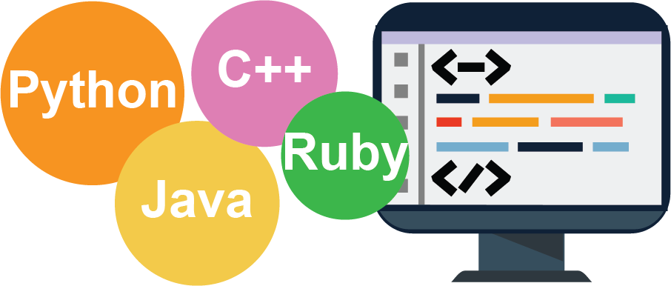
How do computers run programs?
A computer program is a set of instructions that perform a specific task when executed, or carried out, by a computer
A mobile application, or app, is a program that runs on a mobile device, like a phone or tablet
To write a computer program or app, Software Engineers can use many different languages, called programming codes, to write the instructions
Codes, such as Python and Java, are computer languages that are still understandable to humans but are also easily translated into binary

Slide 8
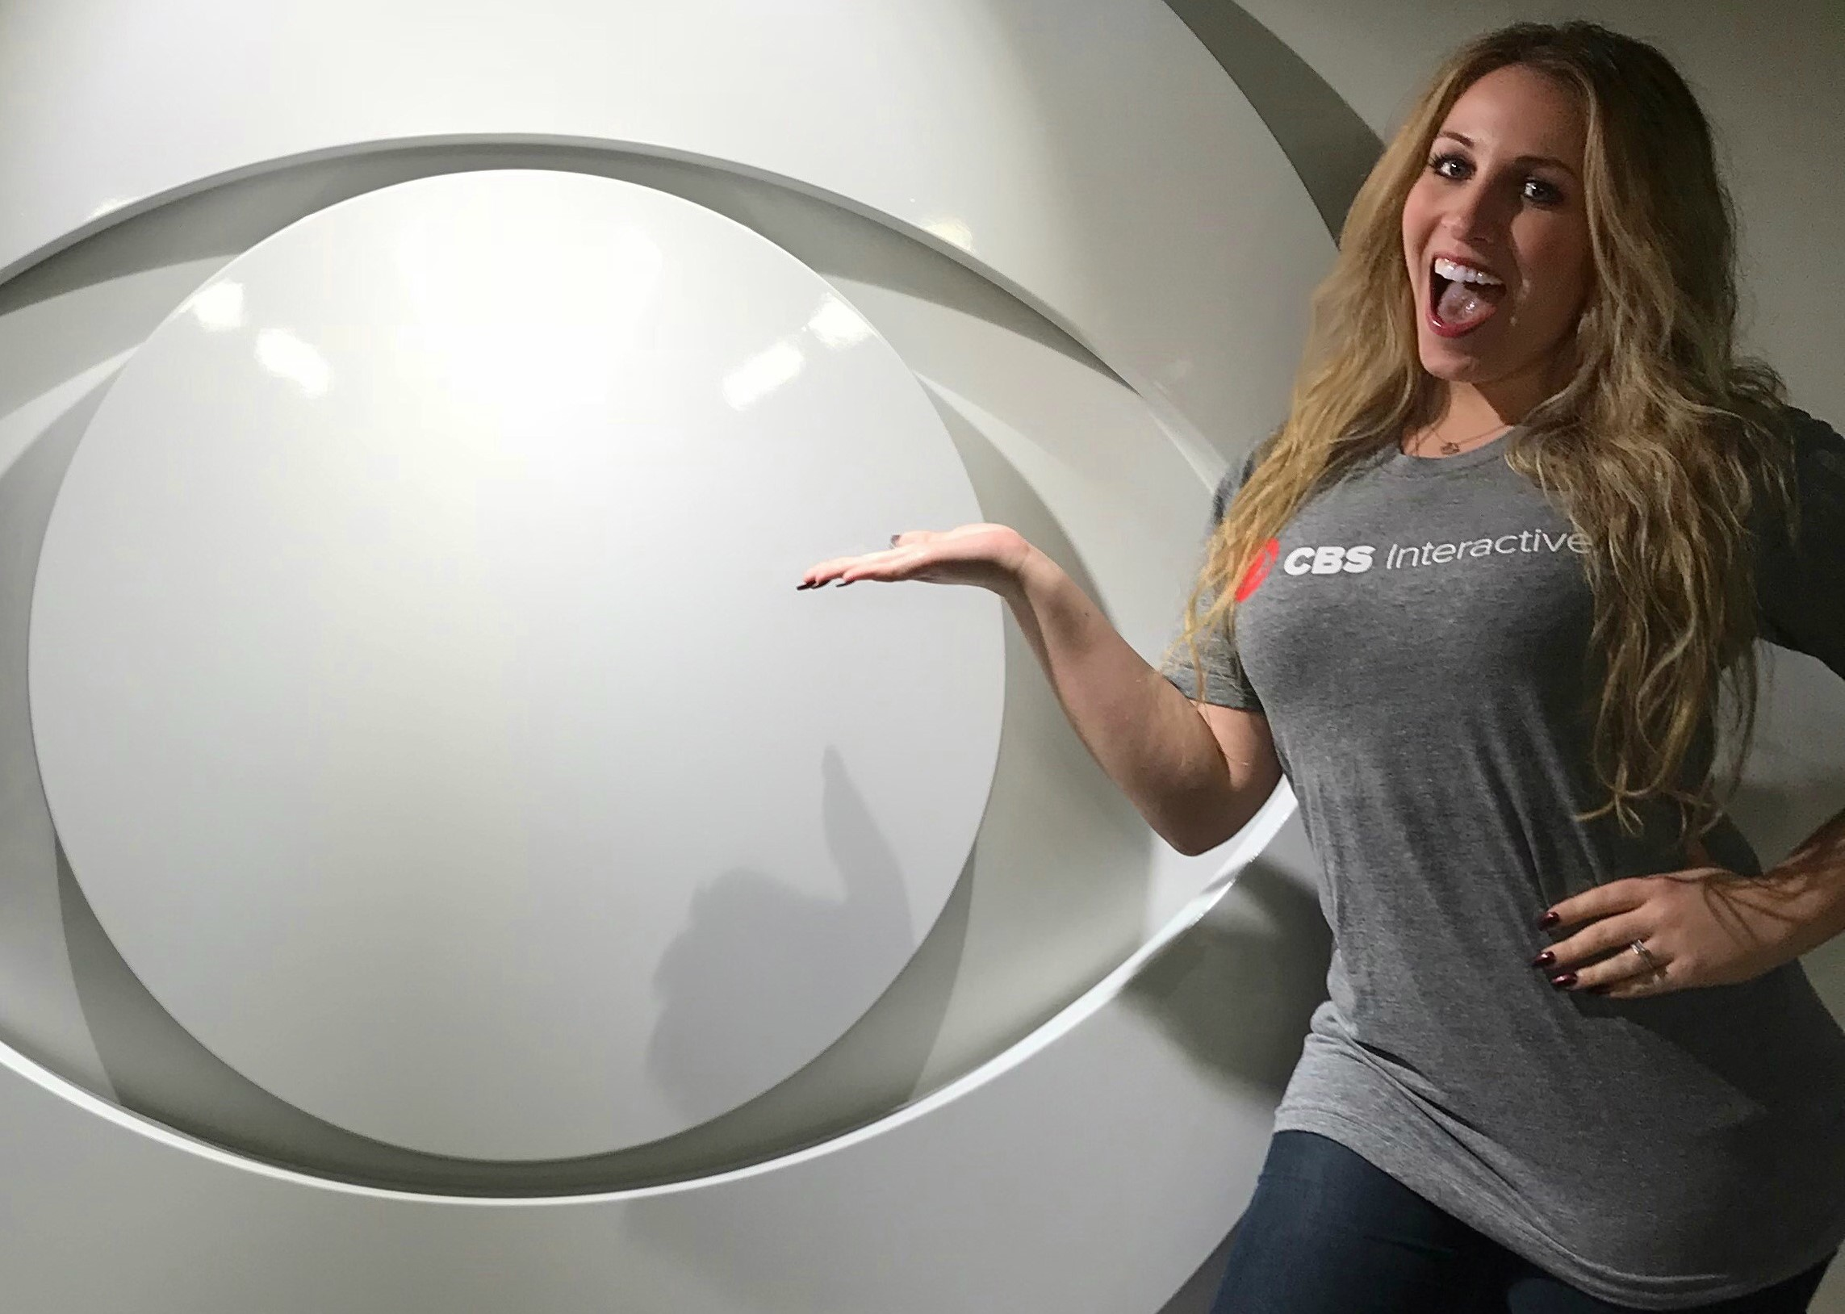

Why care about code?
Engineers, like Science Cheerleaders Samantha and Candess, use code every day. They work in teams and use their problem-solving and creative thinking skills to create programs and apps.
We use machines everyday, and all machines are programmed with code and binary! Devices, like heart rate monitors or your car’s display screen, use code and binary to function.
Understanding binary and programming languages, or even learning to write them yourself, is great way to help imagine and build the next cool tech product.

Slide 9
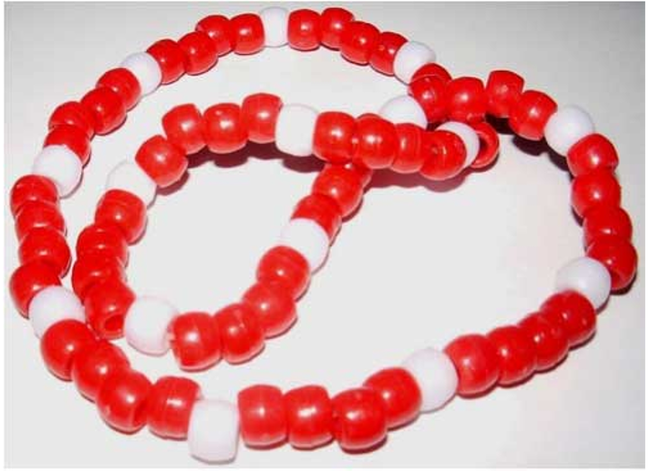
Let’s make binary necklaces!
Use the activity sheet to guide you through this activity!
Materials needed: pencil, paper, colored beads, string
Write your first name
Below each letter, write the matching binary byte
Lay out beads to match the binary
  Red: 0
  White: 1
String all the beads on the string, starting with the first letter

